Slide 1

Cryptography (2022 Fall) $ℤ_{n}$, $ℤ_{n}^{∗}$, group, finite field
LiangFeng Zhang
zhanglf@shanghaitech.edu.cn
SIST, ShanghaiTech

Slide 2
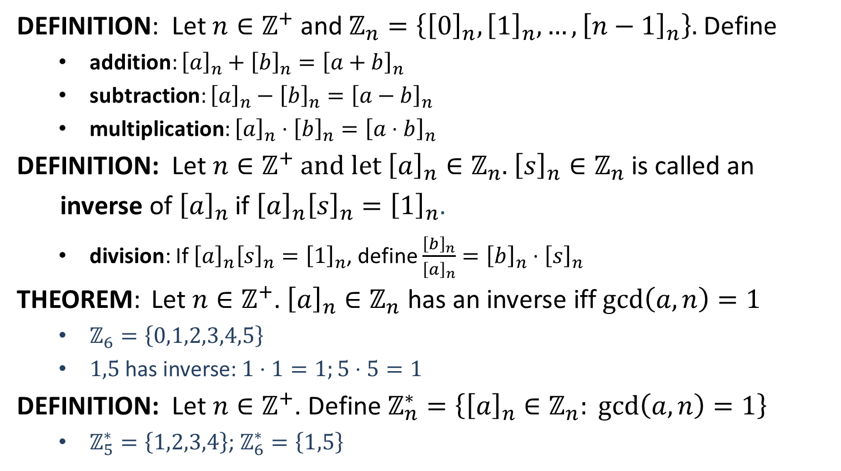
Residue Classes
DEFINITION: Let $n∈ℤ^{+}$ and $ℤ_{n}=\left\{{\left[0\right]}_{n}, {\left[1\right]}_{n}, …, {\left[n−1\right]}_{n}\right\}.$ Define
addition: ${\left[a\right]}_{n}+{\left[b\right]}_{n}={\left[a+b\right]}_{n}$
subtraction: ${\left[a\right]}_{n}−{\left[b\right]}_{n}={\left[a−b\right]}_{n}$
multiplication: ${\left[a\right]}_{n}⋅{\left[b\right]}_{n}={\left[a⋅b\right]}_{n}$
DEFINITION: Let $n∈ℤ^{+}$ and let ${\left[a\right]}_{n}∈ℤ_{n}$. ${\left[s\right]}_{n}∈ℤ_{n}$ is called an
inverse of ${\left[a\right]}_{n}$ if ${\left[a\right]}_{n}{\left[s\right]}_{n}={\left[1\right]}_{n}$.
division: If ${\left[a\right]}_{n}{\left[s\right]}_{n}={\left[1\right]}_{n}$, define $\frac{{\left[b\right]}_{n}}{{\left[a\right]}_{n}}={\left[b\right]}_{n}⋅{\left[s\right]}_{n}$
THEOREM: Let $n∈ℤ^{+}$. ${\left[a\right]}_{n}∈ℤ_{n}$ has an inverse iff $\gcd\left(a,n\right)=1$
$ℤ_{6}=\left\{0,1,2,3,4,5\right\}$
$1,5$ has inverse: $1⋅1=1;5⋅5=1$
DEFINITION: Let $n∈ℤ^{+}$. Define $ℤ_{n}^{∗}=\left\{{\left[a\right]}_{n}∈ℤ_{n}: \gcd\left(a,n\right)=1\right\}$
$ℤ_{5}^{∗}=\left\{1,2,3,4\right\}$; $ℤ_{6}^{∗}=\left\{1,5\right\}$

Slide 3
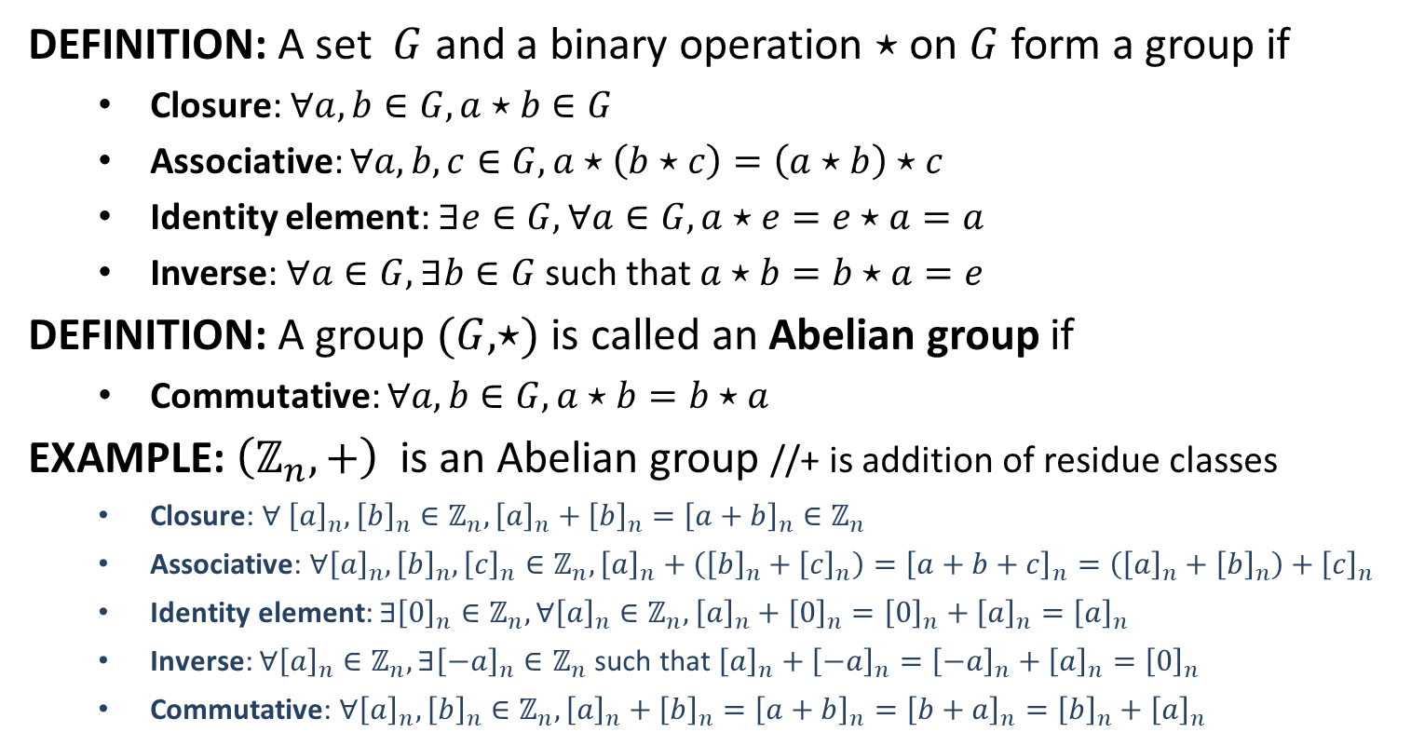
Group
DEFINITION: A set $G$ and a binary operation $⋆$ on $G$ form a group if
Closure: $∀a,b∈G, a⋆b∈G$
Associative: $∀a,b,c∈G, a⋆\left(b⋆c\right)=\left(a⋆b\right)⋆c$
Identity element: $∃e∈G, ∀a∈G, a⋆e=e⋆a=a$
Inverse: $∀a∈G,∃b∈G$ such that $a⋆b=b⋆a=e$
DEFINITION: A group $(G,⋆)$ is called an Abelian group if
Commutative: $∀a,b∈G, a⋆b=b⋆a$
EXAMPLE: $\left(ℤ_{n},+\right)$ is an Abelian group //+ is addition of residue classes
Closure: $∀ {\left[a\right]}_{n},{\left[b\right]}_{n}∈ℤ_{n}, {\left[a\right]}_{n}+{\left[b\right]}_{n}={\left[a+b\right]}_{n}∈ℤ_{n}$
Associative: $∀{\left[a\right]}_{n},{\left[b\right]}_{n},{\left[c\right]}_{n}∈ℤ_{n}, {\left[a\right]}_{n}+\left({\left[b\right]}_{n}+{\left[c\right]}_{n}\right)={\left[a+b+c\right]}_{n}=\left({\left[a\right]}_{n}+{\left[b\right]}_{n}\right)+{\left[c\right]}_{n}$
Identity element: $∃{\left[0\right]}_{n}∈ℤ_{n}, ∀{\left[a\right]}_{n}∈ℤ_{n}, {\left[a\right]}_{n}+{\left[0\right]}_{n}={\left[0\right]}_{n}+{\left[a\right]}_{n}={\left[a\right]}_{n}$
Inverse: $∀{\left[a\right]}_{n}∈ℤ_{n},∃{\left[−a\right]}_{n}∈ℤ_{n}$ such that ${\left[a\right]}_{n}+{\left[−a\right]}_{n}={\left[−a\right]}_{n}+{\left[a\right]}_{n}={\left[0\right]}_{n}$
Commutative: $∀{\left[a\right]}_{n}, {\left[b\right]}_{n}∈ℤ_{n}, {\left[a\right]}_{n}+{\left[b\right]}_{n}={\left[a+b\right]}_{n}={\left[b+a\right]}_{n}={\left[b\right]}_{n}+{\left[a\right]}_{n}$

Slide 4
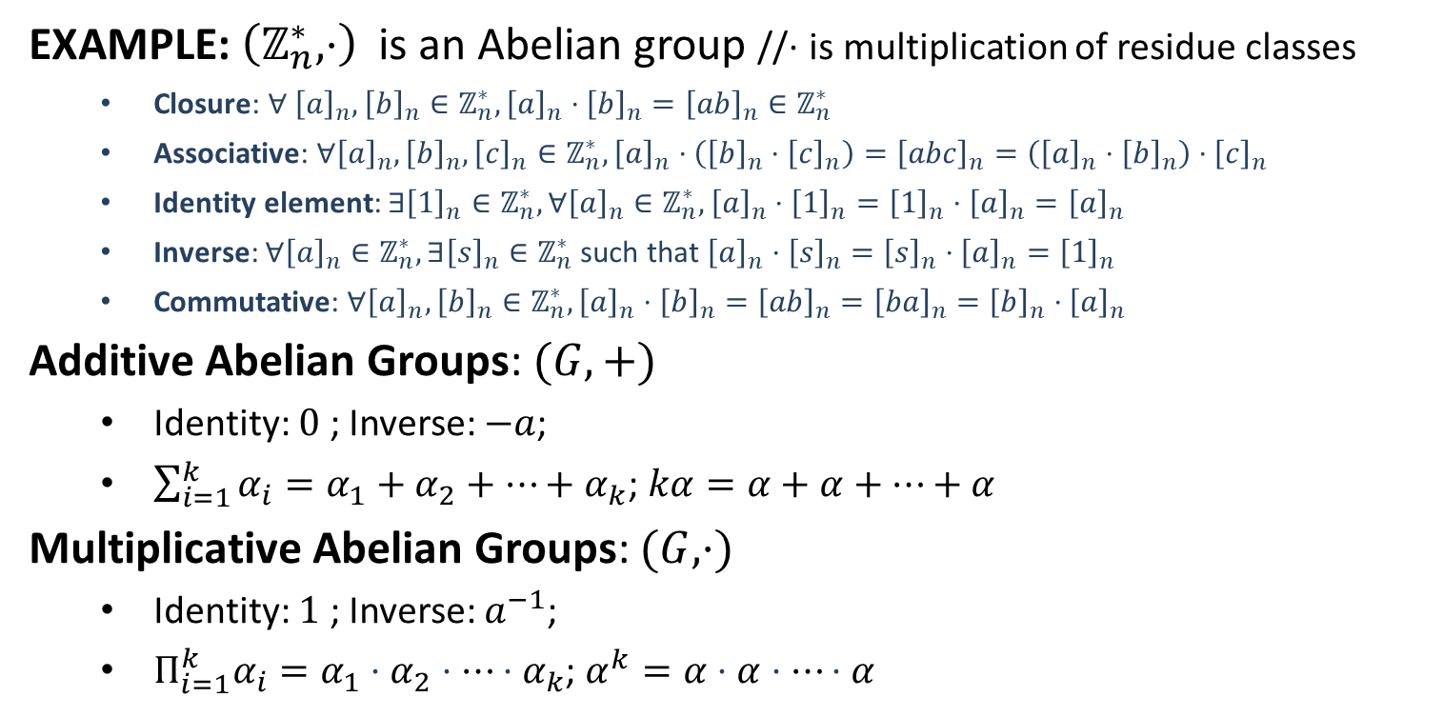
Group
EXAMPLE: $\left(ℤ_{n}^{∗},⋅\right)$ is an Abelian group //$⋅$ is multiplication of residue classes
Closure: $∀ {\left[a\right]}_{n},{\left[b\right]}_{n}∈ℤ_{n}^{∗}, {\left[a\right]}_{n}⋅{\left[b\right]}_{n}={\left[ab\right]}_{n}∈ℤ_{n}^{∗}$
Associative: $∀{\left[a\right]}_{n},{\left[b\right]}_{n},{\left[c\right]}_{n}∈ℤ_{n}^{∗}, {\left[a\right]}_{n}⋅\left({\left[b\right]}_{n}⋅{\left[c\right]}_{n}\right)={\left[abc\right]}_{n}=\left({\left[a\right]}_{n}⋅{\left[b\right]}_{n}\right)⋅{\left[c\right]}_{n}$
Identity element: $∃{\left[1\right]}_{n}∈ℤ_{n}^{∗}, ∀{\left[a\right]}_{n}∈ℤ_{n}^{∗}, {\left[a\right]}_{n}⋅{\left[1\right]}_{n}={\left[1\right]}_{n}⋅{\left[a\right]}_{n}={\left[a\right]}_{n}$
Inverse: $∀{\left[a\right]}_{n}∈ℤ_{n}^{∗},∃{\left[s\right]}_{n}∈ℤ_{n}^{∗}$ such that ${\left[a\right]}_{n}⋅{\left[s\right]}_{n}={\left[s\right]}_{n}⋅{\left[a\right]}_{n}={\left[1\right]}_{n}$
Commutative: $∀{\left[a\right]}_{n}, {\left[b\right]}_{n}∈ℤ_{n}^{∗}, {\left[a\right]}_{n}⋅{\left[b\right]}_{n}={\left[ab\right]}_{n}={\left[ba\right]}_{n}={\left[b\right]}_{n}⋅{\left[a\right]}_{n}$
Additive Abelian Groups: $(G,+)$
Identity: $0$ ; Inverse: $−a$;
$\sum_{i=1}^{k}{α_{i}}=α_{1}+α_{2}+⋯+α_{k}$; $kα=α+α+⋯+α$
Multiplicative Abelian Groups: $(G,⋅)$
Identity: $1$ ; Inverse: $a^{−1}$;
$Π_{i=1}^{k}α_{i}=α_{1}⋅α_{2}⋅⋯⋅α_{k}$; $α^{k}=α⋅α⋅⋯⋅α$

Slide 5
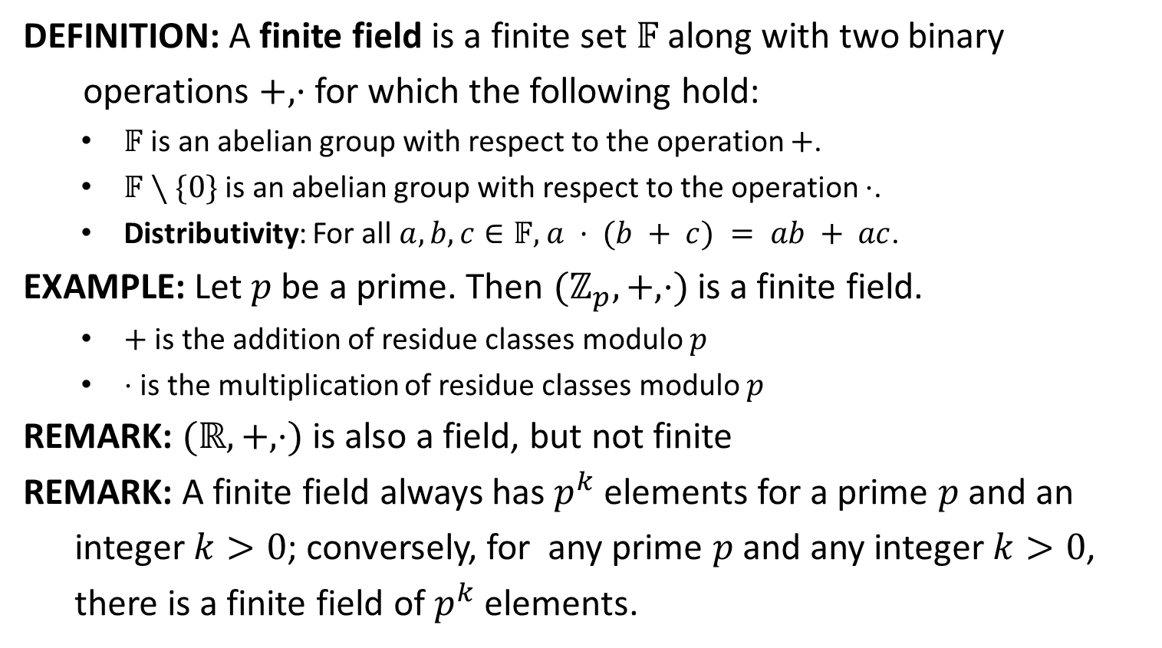
Finite Field
DEFINITION: A finite field is a finite set $𝔽$ along with two binary
operations $+, ·$ for which the following hold:
$𝔽$ is an abelian group with respect to the operation $+$.
$𝔽∖\{0\}$ is an abelian group with respect to the operation $⋅$.
Distributivity: For all $a,b,c∈𝔽,$ $a · (b + c) = ab + ac$.
EXAMPLE: Let $p$ be a prime. Then $(ℤ_{p}, +, ⋅)$ is a finite field.
$+$ is the addition of residue classes modulo $p$
$⋅$ is the multiplication of residue classes modulo $p$
REMARK: $(ℝ,+,⋅)$ is also a field, but not finite
REMARK: A finite field always has $p^{k}$ elements for a prime $p$ and an
integer $k>0$; conversely, for any prime $p$ and any integer $k>0$,
there is a finite field of $p^{k}$ elements.

Slide 6
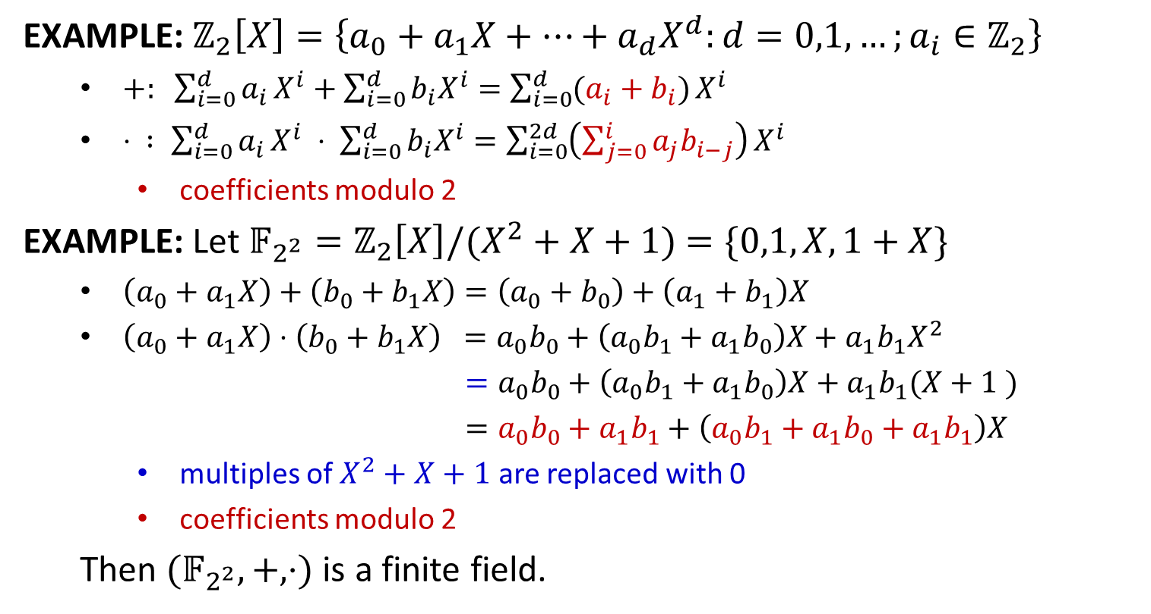
Finite Field
EXAMPLE: $ℤ_{2}\left[X\right]=\left\{a_{0}+a_{1}X+⋯+a_{d}X^{d}:d=0,1,…;a_{i}∈ℤ_{2}\right\}$
$+: \sum_{i=0}^{d}{a_{i}}X^{i}+\sum_{i=0}^{d}{b_{i}X^{i}}=\sum_{i=0}^{d}{(a_{i}+b_{i})}X^{i}$
$⋅ : \sum_{i=0}^{d}{a_{i}}X^{i} ⋅ \sum_{i=0}^{d}{b_{i}X^{i}}=\sum_{i=0}^{2d}{\left(\sum_{j=0}^{i}{a_{j}b_{i−j}}\right)}X^{i}$
coefficients modulo 2
EXAMPLE: Let $𝔽_{2^{2}}=ℤ_{2}\left[X\right]/(X^{2}+X+1)$ $=\{0,1,X,1+X\}$
$\left(a_{0}+a_{1}X\right)+\left(b_{0}+b_{1}X\right)=\left(a_{0}+b_{0}\right)+\left(a_{1}+b_{1}\right)X$
$\left(a_{0}+a_{1}X\right)⋅\left(b_{0}+b_{1}X\right) =a_{0}b_{0}+\left(a_{0}b_{1}+a_{1}b_{0}\right)X+a_{1}b_{1}X^{2}$
$=a_{0}b_{0}+\left(a_{0}b_{1}+a_{1}b_{0}\right)X+a_{1}b_{1}(X+1 )$
$=a_{0}b_{0}+a_{1}b_{1}+\left(a_{0}b_{1}+a_{1}b_{0}+a_{1}b_{1}\right)X$
multiples of $X^{2}+X+1$ are replaced with 0
coefficients modulo 2
Then $(𝔽_{2^{2}},+,⋅)$ is a finite field.

Slide 7
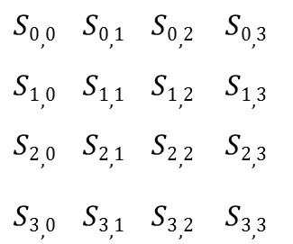
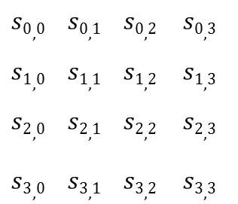
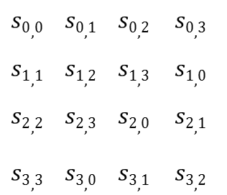

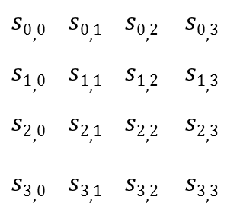

ShiftRows and MixColumns
ShiftRows($s$): shift the rows of the state to the left
$$s0,0 s0,1 s0,2 s0,3$$
$$s1,0 s1,1 s1,2 s1,3$$
$$s2,0 s2,1 s2,2 s2,3$$
$$s3,0 s3,1 s3,2 s3,3$$
$$s0,0 s0,1 s0,2 s0,3$$
$$s1,1 s1,2 s1,3 s1,0$$
$$s2,2 s2,3 s2,0 s2,1$$
$$s3,3 s3,0 s3,1 s3,2$$
$$→$$
MixColumns($s$): Multiplications over $𝔽_{2^{8}}$
02 03 01 01
01 02 03 01
01 01 02 03
03 01 01 02
$$s0,0 s0,1 s0,2 s0,3$$
$$s1,0 s1,1 s1,2 s1,3$$
$$s2,0 s2,1 s2,2 s2,3$$
$$s3,0 s3,1 s3,2 s3,3$$
$$S0,0 S0,1 S0,2 S0,3$$
$$S1,0 S1,1 S1,2 S1,3$$
$$S2,0 S2,1 S2,2 S2,3$$
$$S3,0 S3,1 S3,2 S3,3$$
*
$$→$$

Slide 8
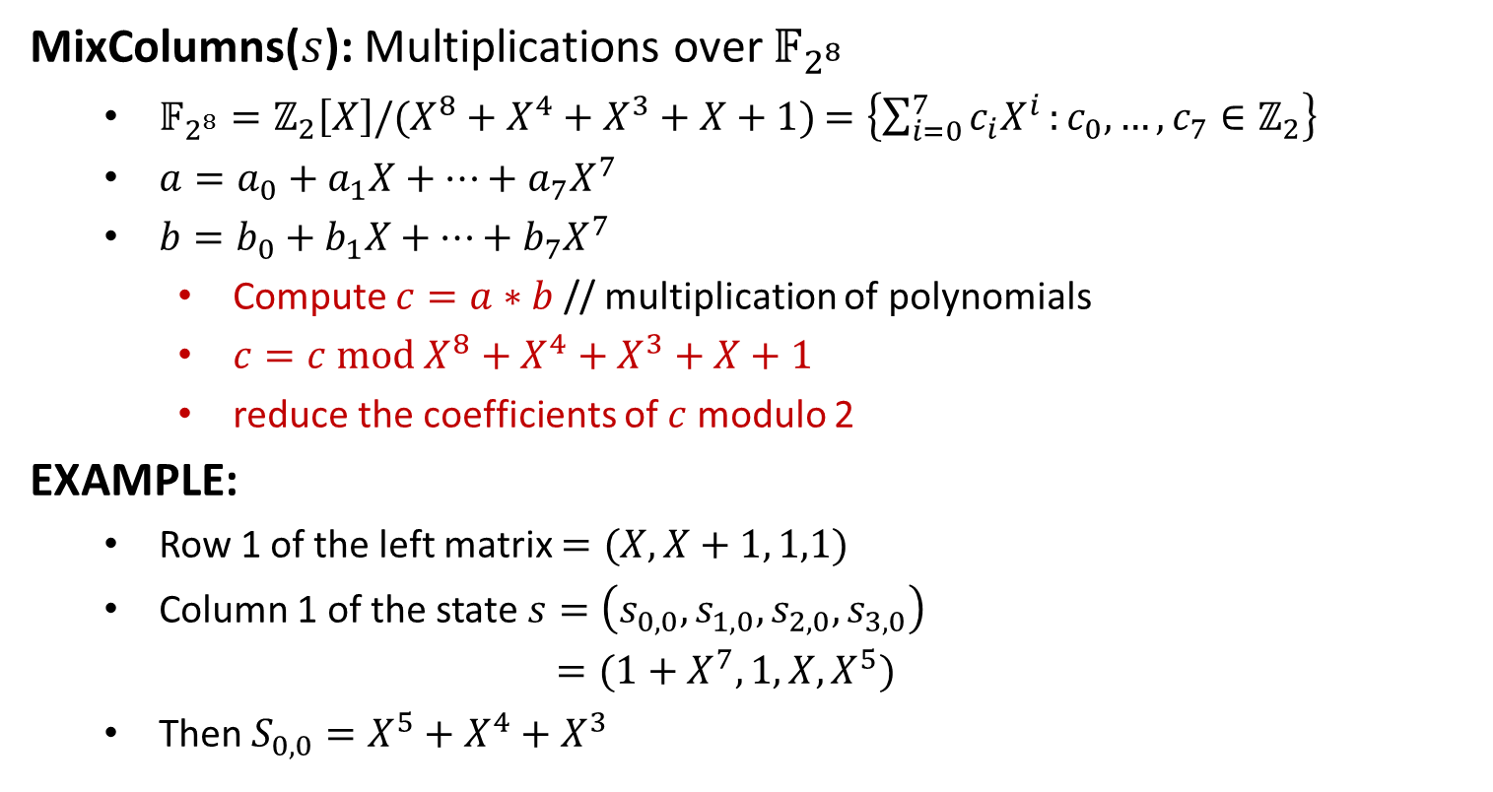
MixColumns
MixColumns($s$): Multiplications over $𝔽_{2^{8}}$
$𝔽_{2^{8}}=ℤ_{2}\left[X\right]/(X^{8}+X^{4}+X^{3}+X+1)$ $=\left\{\sum_{i=0}^{7}{c_{i}X^{i}}:c_{0},…,c_{7}∈ℤ_{2}\right\}$
$a=a_{0}+a_{1}X+⋯+a_{7}X^{7}$
$b=b_{0}+b_{1}X+⋯+b_{7}X^{7}$
Compute $c=a∗b$ // multiplication of polynomials
$c=c mod X^{8}+X^{4}+X^{3}+X+1$
reduce the coefficients of $c$modulo 2
EXAMPLE:
Row 1 of the left matrix $=(X, X+1, 1,1)$
Column 1 of the state $s=\left(s_{0,0},s_{1,0},s_{2,0},s_{3,0}\right)$
$=(1+X^{7}, 1,X,X^{5})$
Then $S_{0,0}=X^{5}+X^{4}+X^{3}$

